Slide 1



21st Century Amblyopia: The Next Decade
Ben Thompson
Department of Optometry and Vision Science, University of Auckland

Slide 2
Overview
An example case
A description of the new treatment apparatus and technique
The scientific basis of the technique

Slide 3
An Example Case
23 year old female
Mixed unilateral amblyopia (combined anisometropia and strabismus)
  Right Eye +0.25/-0.5x180
  Left Eye +2.25/-1.50x110
    3° Esotropia
Amblyopia detected at age 2
Surgery at age 7
Treated with patching during childhood

Slide 4
Visual Acuity

Slide 5
Stereo Sensitivity

Slide 6
The Treatment Device

Slide 7
Background
Hypothesis: Adults with amblyopia have functional but suppressed binocular mechanisms
  Antagonising GABA A receptors can restore binocular responses to neurons within the primary visual cortex of cats made experimentally amblyopic (Mower et al., 1984, Brain Research, 309, 168-172; Sengpiel et al., 2006, Cerebral Cortex, 16, 750-758)
  Binocular summation can occur in adults with strabismic amblyopia if differences in monocular contrast sensitivity are accounted for (Baker et al., 2008, Vision Research, 48, 1625-1640)

Slide 8
Overcoming Suppression
Can the manipulation of contrast differences between the eyes allow for binocular combination in amblyopia?

Slide 9
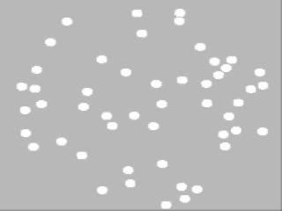
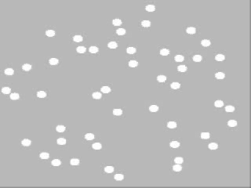
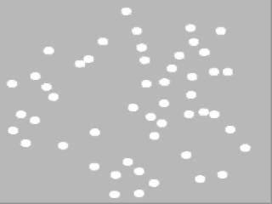
Objective Measurement of Suppression
Signal
Noise
+
=
Mansouri et al. (2008), Vision Research, 48, 2775-2784
Notes:
By reducing the contrast of the stimulus shown to the fellow eye and measuring motion coherence thresholds we can detect the fellow eye contrast at which the signal and noise begin to interact.

Slide 10
Can We Overcome the Suppression?
Mansouri, et al. (2008), Vision Research, 48, 2775-2784
Notes:
Acuity ranged from 20/80 to 2/50 strabismus from 1 degree to 8 degrees.

Slide 11
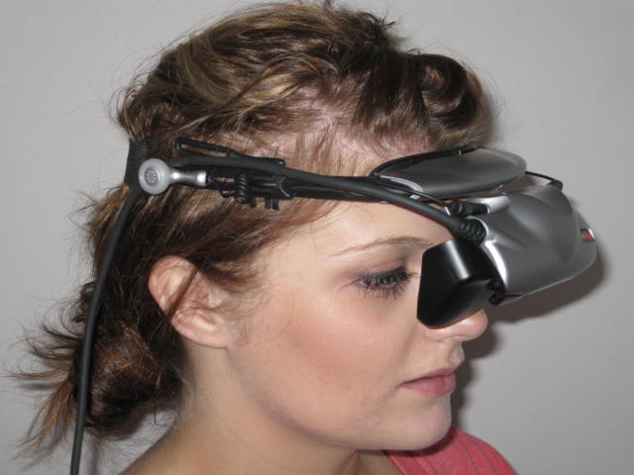
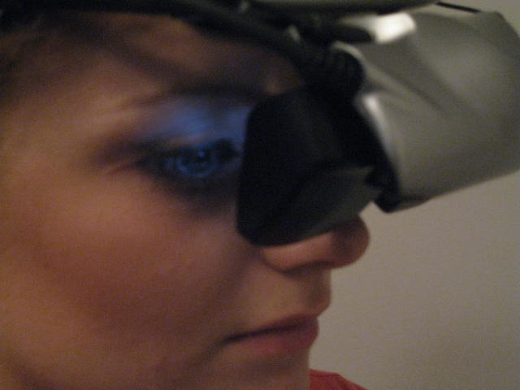
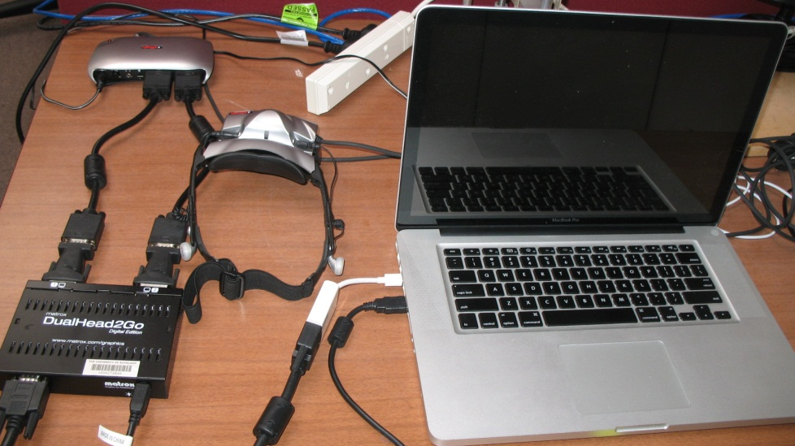
Measuring Suppression in Clinical Settings
Black et al., (2011), Optometry and Vision Science, 88, 334-343.

Slide 12
Reduction of Suppression
Hess et al.,(2010). Restorative Neurology and Neuroscience, 28, 793-802
Notes:
7/9 improved stereo – 2 to 6 weeks training improvements after 5.5 hours. 10,000 trials

Slide 13
Principle Applied to a Portable Device
To et al., (2011), IEEE Transactions on Neural Systems and Rehabilitation Engineering, 19, 280-289.
Notes:
8/10 improved acuity, 6/10 improved stereo acuity – 4 measureable stereo for the first time.

Slide 14
Notes:
2 – 6 weeks of training. Age range 17-51. 5 aniso 5 strabismic. Improvements stable after 3 months.

Slide 15
Notes:
2 – 6 weeks of training. Age range 17-51. 5 aniso 5 strabismic – 0.015 is 66 seconds of arc.

Slide 16
Summary
Binocular function may be present but suppressed in amblyopia
Reducing inhibitory interactions within the amblyopic visual system may improve both monocular and binocular visual function

Slide 17
This might be how JIMMY SMITS has his amblyopia treated in 2015
4 yo
Presents with intermittent esotropia
Lea acuity R 6/9 [near 6/9] , L 6/36 [near 6/48]
L esotropia 25Δ [distance], 30Δ [near]
Cyclo R +2.5 DS, L +3.5 DS
Rx: glasses [full cyclo].
Review monthly
Notes:
4 year old patient presenting with intermittant eso, he demonstrates reduced VA in the left eye and a left eso that is slightly more pronouced at near. Cycloplegic refration demonstrates bilateral hypometroia and anisometropia. Full cycloplegic refraction was given in glasses and he was reviewed at one month.

Slide 18
JIMMY SMITS 2
1 mo later: R 6/7.5, L 6/24. Straight for D&N.
Suppression scotoma 5° diameter.
Bagolini filter bar 8.
2 mo later: R 6/7.5, L 6/21. Straight for D&N
3 mo later: R 6/7.5+, L 6/21.
Suppression scotoma 5° diameter. Bagolini filter bar 8.
Meets criteria for using McGill Tetris ® Gadget ™
  straight eyed anisometropic amblyope
  failed progression of refractive amblyopia treatment .
Attends calibration session to reduce R contrast input to match the L amblyopia
Prescribed 30 minutes daily
Notes:
One month later vision Jimmy’s has improved to 6/24 in the left eye, his eyes are straight at distance and near and he has measurable suppression. Over the next month his VA improves to 6/21 but does not improve further after an additional month of refractive correction. Jimmy meets the criteria for the use of iPod therapy as he has straight eyes and has failed to improve with refractive therapy, therefore his contrast imbalance is measured using the video goggle technique and the appropriate contrast difference between the two eyes is set on the ipod tetris device. Jimmy is prescribed 30 mins of play per day and compliance as well as game performance is reviewed weekly via wireless internet connection to the iPod device.

Slide 19
JIMMY SMITS 3
Glasses wear [weeks] | R acuity 6/ | L acuity 6/ | *Size suppression scotoma ° | **Depth suppression scotoma BFB | Other
0 | 9 | 36 | > 5 | >10 | glasses
4 | 7.5 | 24 | 5 | 8 | glasses
8 | 7.5 | 21 | 5 | 8
12 | 7.5+ | 21 | >5 | 7 | + McGill Tetris Gadget
16 | 7.5- | 18 | 4 | 5
20 | 7.5+ | 12 | 2.5 | 4
24 | 7.5- | 9 | 1.5 | 4
* Using polarized 4 dot test P4D ** using Bagolini Filter Bar BFB
Notes:
Jimmy showed a gradual improvement in left eye VA and a reduction in suppression

Slide 20


Collaborators
Robert Hess, Dept. Ophthalmology, McGill University
Behzad Mansouri, Dept. Internal Medicine, University of Winnipeg
Jeremy Cooperstock, Dept. Computer Engineering, McGill University
Joanna Black, Dept Optometry and Vision Science, University of Auckland
Health Research Council
of New Zealand

